Slide 1
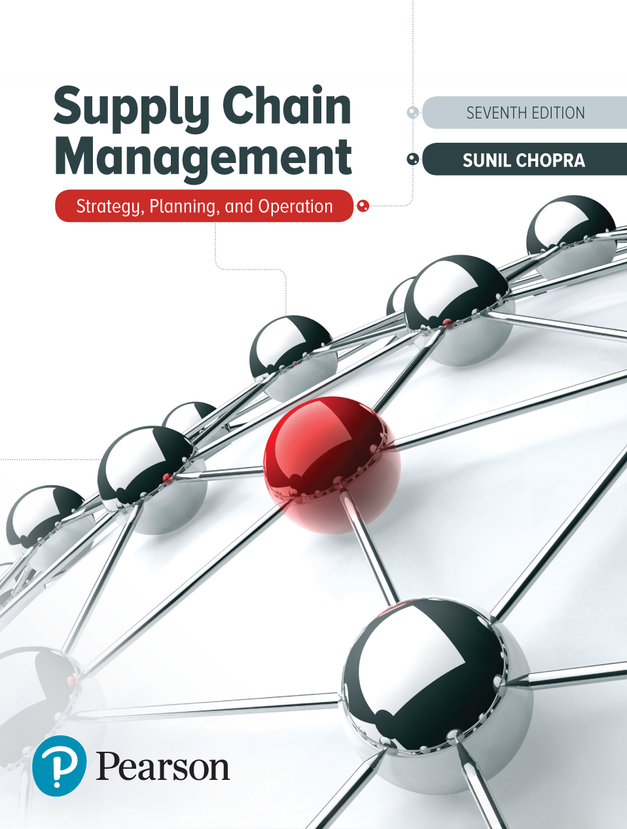
Supply Chain Management: Strategy, Planning, and Operation
Seventh Edition
Chapter 15
Sourcing Decisions in a Supply Chain
Copyright © 2019, 2016, 2013 Pearson Education, Inc. All Rights Reserved
Notes:
If this PowerPoint presentation contains mathematical equations, you may need to check that your computer has the following installed:
1) MathType Plugin
2) Math Player (free versions available)
3) NVDA Reader (free versions available)

Slide 2
Learning Objectives
15.1 Understand factors that affect the decision to outsource a supply chain function.
15.2 Identify dimensions of supplier performance that affect total cost.
15.3 Design a tailored supplier portfolio.
15.4 Describe the impact of incentives on the behavior of third-parties in a supply chain.
15.5 Discuss the benefits of sharing risk and reward in a supply chain.

Slide 3
The Sourcing Decision in a Supply Chain (1 of 2)
Purchasing, also procurement, is the process by which companies acquire raw materials, components, products, services, or other resources from suppliers to execute their operations
Sourcing – entire set of business processes required to purchase goods and services
Outsourcing – supply chain function being performed by a third party

Slide 4
The Sourcing Decision in a Supply Chain (2 of 2)
Outsourcing questions
Will the third party increase the supply chain surplus relative to performing the activity in-house?
To what extent do risks grow upon outsourcing?
Are there strategic reasons to outsource?

Slide 5
How Do Third Parties Increase the Supply Chain Surplus?
Decisions based on supply chain surplus and risk incurred
Third parties increase surplus through
Capacity aggregation
Inventory aggregation
Transportation aggregation by transportation intermediaries
Transportation aggregation by storage intermediaries
Warehousing aggregation
Procurement aggregation
Information aggregation
Receivables aggregation
Relationship aggregation
Lower costs and higher quality

Slide 6
Factors Influencing Growth of Surplus by a Third Party (1 of 2)
Scale
Large scale it is unlikely that a third party can achieve further scale economies and increase the surplus
Uncertainty
If requirements are highly variable over time, third party can increase the surplus through aggregation
Specificity of assets
If assets required are specific to a firm, a third party is unlikely to increase the surplus
Cost and quantity of available capital
Third party may have available or lower cost capital

Slide 7
Factors Influencing Growth of Surplus by a Third Party (2 of 2)
Table 15-1 Growth in Surplus by Third Party as a Function of Scale, Uncertainty, and Specificity
Blank | Blank | Specificity of Assets Involved in Function (Low) | Specificity of Assets Involved in Function (High)
Firm scale | Low | High growth in surplus | Low to medium growth in surplus
Blank | High | Low growth in surplus | No growth in surplus unless cost of capital is lower for third party
Demand uncertainty for firm | Low | Low to medium growth in surplus | Low growth in surplus
Blank | High | High growth in surplus | Low to medium growth in surplus

Slide 8
Risks of Using a Third Party
The process is broken
Underestimation of the cost of coordination
Reduced customer/supplier contact
Loss of internal capability and growth in third-party power
Leakage of sensitive data and information
Ineffective contracts
Loss of supply chain visibility
Negative reputational impact

Slide 9
Strategic Factors in Sourcing
Support for the business strategy
Improve firm focus

Slide 10
Examples of Successful Third-Party Suppliers
E M S providers
U P S
Li & Fung
Magna Steyr

Slide 11
Summary of Learning Objective 1
Good sourcing decisions aim to identify suppliers that will grow the supply chain surplus. A supply chain function should be outsourced if the third party can increase the supply chain surplus without significant risk. A third party may increase the surplus by aggregating capacity, inventory, warehousing, transportation, information, receivables, and other factors to a higher level than the firm can on its own. A growth in surplus may also occur if the third party has lower costs or higher quality because of specialization or learning. Outsourcing generally makes sense if a firm’s needs are small and highly uncertain and can be served using resources that can serve other firms as well. Outsourcing also makes sense if the firm is short of capital or if the third party has a lower cost of capital.

Slide 12
Total Cost of Ownership (1 of 4)
Mistake to focus only on quoted price
Total cost of ownership (T C O)
Includes all supply chain costs of sourcing from a particular supplier
Three “buckets”
Acquisition costs
Ownership costs
Post-ownership costs

Slide 13
Total Cost of Ownership (2 of 4)
Table 15-2 Factors Influencing Total Cost of Ownership
Performance Category | Category Components | Quantifiable?
Acquisition Costs | Blank | Blank
Supplier price | Labor, material, and overhead | Yes
Supplier terms | Net payment terms, delivery frequency, minimum lot size, quantity discounts | Yes
Taxes and duties | All tariffs and compliance costs | Yes
Delivery costs | All transportation costs from source to destination, packaging costs | Yes
Incoming quality costs | Cost of inspection, defectives, and rework | Yes
Management costs | Cost of managing and planning the purchase | Difficult

Slide 14
Total Cost of Ownership (3 of 4)
Table 15-2 [Continued]
Performance Category | Category Components | Quantifiable?
Ownership Costs | Blank | Blank
Inventory costs | Supplier inventory, including raw material, in process and finished goods, in-transit inventory, finished goods inventory in supply chain | Yes
Warehousing cost | Warehousing and material handling costs to support additional inventory | Yes
Manufacturing costs | Cost of manufacturing associated with the sourced part | Yes
Production quality costs | Impact of sourced part on finished product quality | Difficult
Cycle time costs | Impact of sourced part on production cycle time | Yes

Slide 15
Total Cost of Ownership (4 of 4)
Table 15-2 [Continued]
Performance Category | Category Components | Quantifiable?
Post-Ownership Costs | Blank | Blank
Reputation | Reputation impact of quality problems | No
Warranty and product liability costs | Warranty and product liability costs associated with sourced part | Difficult
Environmental costs | Environmental costs affected by sourced part | Difficult
Supplier capabilities | Replenishment lead time, on-time performance, flexibility, information coordination capability, design coordination capability, supplier viability | To some extent

Slide 16
Summary of Learning Objective 2
Supplier performance should be compared based on the impact on total cost of ownership. Total cost includes the cost of acquisition, ownership, and post-ownership. In addition to the supplier price, the total cost of using a supplier is affected by the supplier terms; delivery costs; inventory costs; warehousing costs; quality costs; costs of management effort and administrative support; impact on reputation; supplier capabilities, such as replenishment lead time, on-time performance, and flexibility; and other costs, such as exchange rate trends, taxes, and duties. In many instances, a higher acquisition cost is more than compensated for by lower ownership and post-ownership costs.

Slide 17
Designing a Sourcing Portfolio: Tailored Sourcing (1 of 5)
Options with regard to whom and where to source from
Produce in-house or outsource to a third party
Will the source be cost efficient or responsive
Onshoring, near-shoring, and offshoring
Tailor supplier portfolio based on a variety of product and market characteristics

Slide 18
Designing a Sourcing Portfolio: Tailored Sourcing (2 of 5)
Sources must focus on different capabilities
Cost
Responsiveness
Volume-based tailored sourcing
Product-based tailored sourcing

Slide 19
Designing a Sourcing Portfolio: Tailored Sourcing (3 of 5)
Table 15.3 Factors Favoring Selection of a Responsive or Low-Cost Source
Blank | Responsive Source | Low-Cost Source
Product life cycle | Early phase | Mature phase
Demand volatility | High | Low
Demand volume | Low | High
Product value | High | Low
Rate of product obsolescence | High | Low
Desired quality | High | Low to medium
Engineering/design support | High | Low

Slide 20
Designing a Sourcing Portfolio: Tailored Sourcing (4 of 5)
Table 15.4 Factors Favoring Onshoring, Near-Shoring, or Offshoring
Blank | Onshore | Near-Shore | Offshore
Rate of innovation/product variety | High | Medium to High | Low
Demand volatility | High | Medium to High | Low
Labor content | Low | Medium to High | High
Volume or weight-to-value ratio | High | High | Low
Impact of supply chain disruption | High | Medium to High | Low
Inventory costs | High | Medium to High | Low
Engineering/management support | High | High | Low

Slide 21
Designing a Sourcing Portfolio: Tailored Sourcing (5 of 5)
Table 15.5 Differences Between Direct and Indirect Materials
Blank | Direct Materials | Indirect Materials
Use | Production | Maintenance, repair, and support operations
Accounting | Cost of goods sold | Selling, general, and administrative expenses (S G&A)
Impact on production | Any delay will delay production | Less direct impact
Processing cost relative to value of transaction | Low | High
Number of transactions | Low | High

Slide 22
Product Categorization
Figure 15-1 Product Categorization by Value and Criticality

Slide 23
Summary of Learning Objective 3
Firms must consider a tailored sourcing strategy that couples responsive onshore or near-shore sources with low-cost offshore sources. The responsive onshore sources should focus on high-value products with high demand volatility, whereas the low-cost, offshore sources should focus on lower-value, high-volume products with high labor content. Sourcing can also be tailored based on direct and indirect materials as well as the criticality and cost of items purchased.

Slide 24
The Impact of Incentives on Third-Party Behavior
Misalignment of incentives often hurts supply chain performance
Alignment important
When third party actions are not fully observable
When third party has information not available to the firm
Well-designed incentives can be strong communicators of desired performance
“Threshold” incentives can distort information

Slide 25
Summary of Learning Objective 4
Supply chain incentives can have unintended consequences when the third party’s information and actions are hard to observe. It is important to understand and address the negative consequences of these incentives to ensure that the third-party acts in a way that grows the supply chain surplus.

Slide 26
Sharing Risk and Reward in the Supply Chain
Independent actions by two parties often result in lower profits than could be achieved
Stronger firms tend to push risk on to supply chain partners

Slide 27
Optimal Service Level Equations (1 of 2)
p: sale price; c: purchase cost; s: salvage value; µ: mean demand; σ: standard deviation of demand; C S L*: optimal cycle service level; O*: optimal order quantity

Slide 28
Optimal Service Level Equations (2 of 2)

Slide 29
Impact of Local Optimization (1 of 2)
Selling compact disks – Independent retailer
Manufacturing cost = $1
Wholesale price = $5
Retail price = $10
Mean demand = 1,000
Standard deviation = 300
C_{o} = $5 C_{u} = $5
Order = N O R M I N V(0.5, 1000, 300) = 1,000 disks
Expected profits = $3,803
Manufacturer makes $4,000
Total supply chain profit = $3,803 + $4,000 = $7,803

Slide 30
Impact of Local Optimization (2 of 2)
Selling compact disks – Vertically integrated
Manufacturing cost = $1
Wholesale price = $5
Retail price = $10
Mean demand = 1,000
Standard deviation = 300
C_{o} = $1 C_{u} = $9
Order = N O R M I N V(0.9, 1000, 300) = 1,384 disks
Total supply chain profit = $8,474

Slide 31
Sharing Risk to Grow Supply Chain Profits (1 of 2)
Three approaches to risk sharing increase overall supply chain profits
Buyback or returns
Revenue sharing
Quantity flexibility

Slide 32
Sharing Risk to Grow Supply Chain Profits (2 of 2)
Three questions
How will risk sharing affect the firm’s profits and total supply chain profits?
Will risk sharing introduce any information distortion?
How will risk sharing influence supplier performance along key performance measures?

Slide 33
Sharing Risks through Buybacks
Allows a retailer to return unsold inventory up to a specified amount at an agreed upon price
Buyback contract
The manufacturer specifies a wholesale price c and a buyback price b
The manufacturer can salvage $s_{M} for any units that the retailer returns
The manufacturer has a cost of v per unit produced and the retail price is p

Slide 34
Impact of Risks Sharing Through Buybacks
Selling compact disks – Buybacks
Buyback price = $3
Expected profit = $4,286
Expected overstock = 223
Total supply chain profit = $4,286 + $4,011 = $8,297

Slide 35
Buyback Contracts (1 of 2)
Table 15-6 Order Sizes and Profits in Music Supply Chain Under Different Buyback Contracts
Wholesale Price c | Buyback Price b | Optimal Order Size for Music Store | Expected Profit for Music Store | Expected Returns to Supplier | Expected Profit for Supplier | Expected Supply Chain Profit
$5 | $0 | 1,000 | $3,803 | 120 | $4,000 | $7,803
$5 | $2 | 1,096 | $4,090 | 174 | $4,035 | $8,125
$5 | $3 | 1,170 | $4,286 | 223 | $4,009 | $8,295
$6 | $0 | 924 | $2,841 | 86 | $4,620 | $7,461
$6 | $2 | 1,000 | $3,043 | 120 | $4,761 | $7,804
$6 | $4 | 1,129 | $3,346 | 195 | $4,865 | $8,211
$7 | $0 | 843 | $1,957 | 57 | $5,056 | $7,013
$7 | $4 | 1,000 | $2,282 | 120 | $5,521 | $7,803
$7 | $6 | 1,202 | $2,619 | 247 | $5,732 | $8,351

Slide 36
Buyback Contracts (2 of 2)
Holding-cost subsidies
Manufacturers pay retailers a certain amount for every unit held in inventory over a given period
Encourage retailers to order more
Price support
Manufacturers share the risk of product becoming obsolete
Guarantee that in the event they drop prices they will lower prices for all current inventories

Slide 37
Risk Sharing through Revenue-Sharing
Revenue-sharing, manufacturer charges the retailer a low wholesale price c and shares a fraction f of the retailer’s revenue
Allows both the manufacturer and retailer to increase their profits
Results in lower retailer effort
Requires an information infrastructure
Information distortion results in excess inventory in the supply chain and a greater mismatch of supply and demand

Slide 38
Revenue-Sharing Contracts (1 of 3)
Expected manufacturers profits
Expected retailer profit

Slide 39
Revenue-Sharing Contracts (2 of 3)
Selling compact disks – Revenue sharing
Wholesale price c = $1
Revenue share f = .45
Expected profit = $4,369
Expected overstock = 302
Manufacturer profit = $4,068
Total supply chain profit = $4,369 + $4,068 = $8,437

Slide 40
Revenue-Sharing Contracts (3 of 3)
Table 15-7 Order Sizes and Profits in Music Supply Chain Under Different Revenue-Sharing Contracts
Wholesale Price c | Revenue-Sharing Fraction f | Optimal Order Size for Music Store | Expected Overstock at Music Store | Expected Profit for Music Store | Expected Profit for Supplier | Expected Supply Chain Profit
$1 | 0.30 | 1,320 | 342 | $5,526 | $2,934 | $8,460
$1 | 0.45 | 1,273 | 302 | $4,064 | $4,367 | $8,431
$1 | 0.60 | 1,202 | 247 | $2,619 | $5,732 | $8,350
$2 | 0.30 | 1,170 | 223 | $4,286 | $4,009 | $8,295
$2 | 0.45 | 1,105 | 179 | $2,881 | $5,269 | $8,150
$2 | 0.60 | 1,000 | 120 | $1,521 | $6,282 | $7,803

Slide 41
Risk Sharing Using Quantity Flexibility (1 of 2)
Allows the buyer to modify the order (within limits) after observing demand
Better matching of supply and demand
Increased overall supply chain profits if the supplier has flexible capacity
Lower levels of information distortion than either buyback contracts or revenue sharing contracts

Slide 42
Risk Sharing Using Quantity Flexibility (2 of 2)
Retailer orders O units
Manufacturer commits to
Retailer commits to

Slide 43
Quantity Flexibility Contracts (1 of 5)
Expected quantity purchased by retailer, Q_{R}
Expected quantity sold by retailer, D_{R}

Slide 44
Quantity Flexibility Contracts (2 of 5)
Expected quantity overstock at manufacturer
Expected retailer profit
Expected manufacturer profit

Slide 45
Quantity Flexibility Contracts (3 of 5)
Selling compact disks – Quantity flexibility
v = $1 c = $5 p = $10
α = 0.05 β = 0.005 O = 1,017
S_{R} = 0 S_{M} = 0
Manufacturer commits to between

Slide 46
Quantity Flexibility Contracts (4 of 5)
Selling compact disks – Quantity flexibility
Expected quantity purchased by retailer,
Expected quantity sold by retailer,
Expected overstock at retailer
Expected retailer
profit
Expected manufacturer profit
Total supply chain profit = $4,038 + $4,006 = $8,044

Slide 47
Quantity Flexibility Contracts (5 of 5)
Table 15-8 Profits at Music Supply Chain Under Different Quantity Flexibility Contracts
α | β | Wholesale Price c | Order Size O | Expected Purchase by Retailer | Expected Sale by Retailer | Expected Profits for Retailer | Expected Profits for Supplier | Expected Supply Chain Profit
0.00 | 0.00 | $5 | 1,000 | 1,000 | 880 | $3,803 | $4,000 | $7,803
0.05 | 0.05 | $5 | 1,017 | 1,015 | 911 | $4,038 | $4,006 | $8,044
0.20 | 0.20 | $5 | 1,047 | 1,023 | 967 | $4,558 | $3,858 | $8,416
0.00 | 0.00 | $6 | 924 | 924 | 838 | $2,841 | $4,620 | $7,461
0.20 | 0.20 | $6 | 1,000 | 1,000 | 955 | $3,547 | $4,800 | $8,347
0.30 | 0.30 | $6 | 1,021 | 1,006 | 979 | $3,752 | $4,711 | $8,463
0.00 | 0.00 | $7 | 843 | 843 | 786 | $1,957 | $5,056 | $7,013
0.20 | 0.20 | $7 | 947 | 972 | 936 | $2,560 | $5,666 | $8,226
0.40 | 0.40 | $7 | 1,000 | 1,000 | 987 | $2,873 | $5,600 | $8,473

Slide 48
Sharing Rewards to Improve Performance
A buyer may want performance improvement from a supplier who otherwise would have little incentive to do so
A shared-savings contract provides the supplier with a fraction of the savings that result from performance improvement
Effective in aligning supplier and buyer incentives when the supplier is required to improve performance and most of the benefits of improvement accrue to the buyer

Slide 49
Summary of Learning Objective 5 (1 of 2)
Local optimization hurts the supply chain surplus when risk and reward are not shared in a supply chain. Suppliers are more likely to act in a firm’s interest when risk and reward are shared. In the absence of risk sharing, retailers aim for a lower level of product availability than would be required to maximize supply chain profits. The use of buyback or revenue sharing is an effective risk sharing mechanism between suppliers and retailers for products like books with low variable costs. In general, however, quantity flexibility contracts are more effective because they result in a better matching of supply and demand.

Slide 50
Summary of Learning Objective 5 (2 of 2)
Sharing the rewards from improvements can induce performance improvement from a supplier along dimensions, such as lead time, for which the benefit of improvement accrues primarily to the buyer but the effort for improvement comes primarily from the supplier.

Slide 51

Copyright

